Slide 1

NEW ARK — AIRSPACE SECURITY
SV-A ANALYTIC RF
COUNTER-UAS IDENTIFICATION & GOVERNED RESPONSE
Listen first. Identify precisely. Act only under authority.
TTP PROJECT REFERENCE · v1.0 · OCTOBER 2026
PROJECT ASSESSMENT ONLY — NOT AN OPERATING PROCEDURE
newarkcuas.com/airspace-security

Slide 2
01 — CAPABILITY ENVELOPE
Project reference values, framed for site validation
01–10 km
24 / 7
0.1–6.2
360°
SYSTEM-LEVEL COVERAGE REFERENCE
CONTINUOUS-OPERATION ASSESSMENT
GHz · MODEL-SPECIFIC SPECTRUM REFERENCE
MULTI-TARGET · COORDINATED MULTI-NODE
Radius varies by model, site, target environment and written validation.
Subject to site networks, power, accountable personnel and authority conditions.
Band configuration is model-specific; no universal figure applies.
All models cover 360° and fuse C2, radar, acoustic and EO/IR inputs.
Values are project references, not guaranteed performance. Actual configuration, legality and fit require site validation and competent-authority approval.
Source: newarkcuas.com / SV-A Airspace Security public project reference (2026-10).
NEW ARK · SV-A ANALYTIC RF · AIRSPACE SECURITY PROJECT REFERENCE
02 / 24

Slide 3
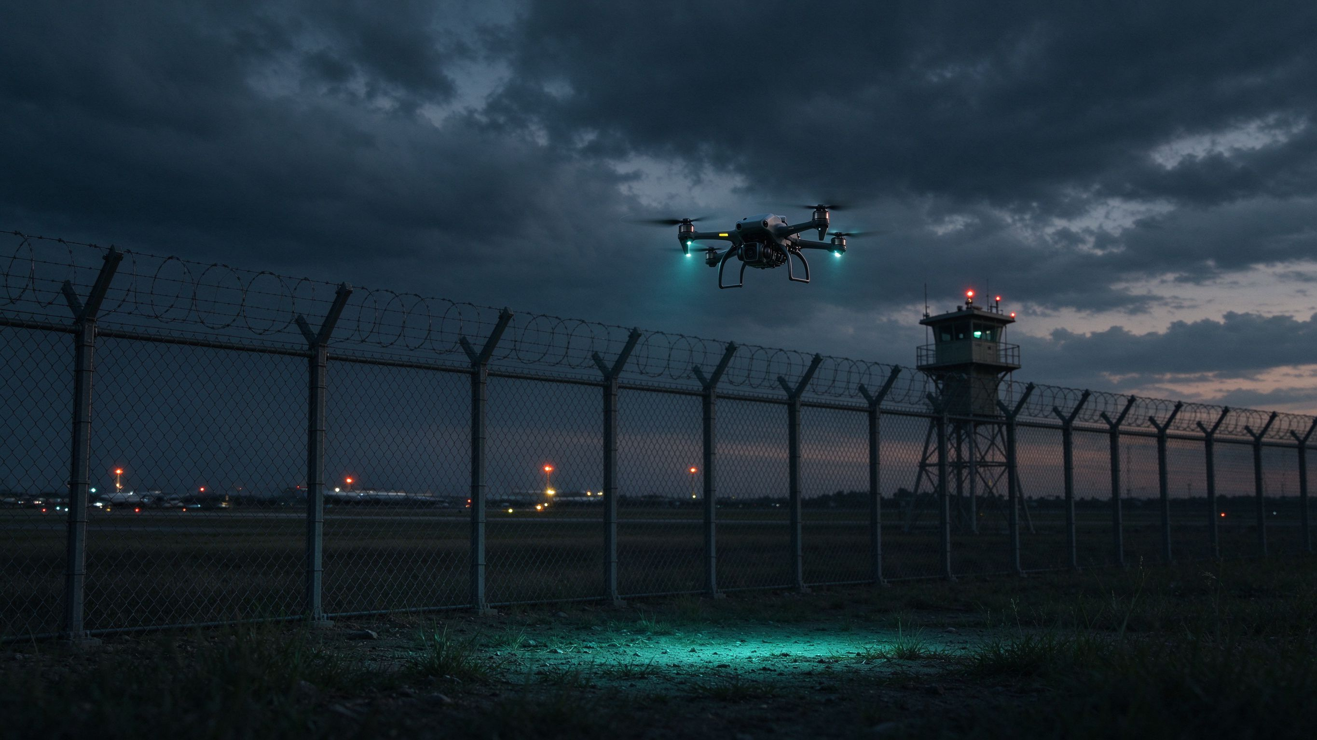
02 — THREAT PICTURE
A drone incursion is a six-phase event; passive sensing must win phase one
01
Launch & approach
Low-altitude ingress; RF-silent pre-programmed flight possible.
02
Perimeter ingress
First detection window across the fence or buffer zone.
03
Reconnaissance & loiter
Camera link active; passive payload may be gathering data.
04
Payload delivery
Kinetic or electronic effect — once here, jamming is already late.
Figure 1 · Airfield-perimeter context — owner-provided reference footage, not a verified incident.
05
Link loss / autonomous flight
Waypoint hold or return-home continues with no RF to jam.
Every broadcast incident and every site briefing shows the same shape: a timeline that begins well before the fence line and ends long after the link is lost.
06
Escape & recovery
Pilot relocates; the evidence chain must survive the event.
Wideband barrage jamming targets only the link in phases 2–4; it is blind to phase 1, the autonomous phase 5, and the escaping pilot in phase 6.
C-UAS industry doctrine; for readiness discussion only. Footage details are not independently verified.
NEW ARK · SV-A ANALYTIC RF · AIRSPACE SECURITY PROJECT REFERENCE
03 / 24

Slide 4
03 — WHY BANDWIDTH ALONE FAILS
Wideband barrage jamming is a compliance and engineering dead end
01
Collateral spectrum harm
05
Power wall
Disrupts civil-aviation RNP, GNSS, public mobile, own-force links; cross-border emissions create diplomatic risk.
A 1000 W-rated amplifier delivers roughly 100–200 W effective mean once PAPR backoff is accounted for.
02
Legal red line
06
Cannot stay on
An illegal flight cannot be answered with an illegal emission; radio regulations and licensing still apply.
Thermal load, EMC load and duty-cycle limits rule out 24/7 wideband emission.
03
Countered by modern links
07
Fails in RF clutter
FHSS (50–100 hops/s), multi-link microwave+LTE+LEO, CRPA nulling, autonomous navigation and swarms.
Dense urban and industrial electromagnetic environments destroy wideband selectivity.
04
Blind by design
08
Cost & audit gap
No identification, no operator geolocation, no evidence record — nothing for a court or an after-action review.
High SWaP-C per protected kilometre, with no health monitoring, log trail or change control.
References: public reporting on the El Paso international-airport GPS-jamming exercise (aviation disruption); independent RF engineering analyses (Aminext, Corvus, Simplico); documented 15 km-class interference radii.
NEW ARK · SV-A ANALYTIC RF · AIRSPACE SECURITY PROJECT REFERENCE
04 / 24

Slide 5
04 — TECHNOLOGY PRINCIPLE
Identify, corroborate, authorise, audit — an RF-silent project path
01
02
03
SPECTRUM-CONTEXT REVIEW
MULTI-SOURCE CORROBORATION & EVENT TIERING
AUTHORISED INTERFACE & AUDIT
Within an authorised monitoring scope, review project-relevant signals together with defined protection rules for lawful services.
Corroborate radar, acoustic, EO/IR and field-event information; escalate alerts under project-defined rules.
Assess any governed interface only where permissions, site conditions, human roles and written procedures are satisfied; retain records.
WHAT THE NODE ACTUALLY DOES
RF-silent passive reception
Device & protocol fingerprint
AOA / TDOA operator geolocation
Protocol-level safe-landing assessment
The public page presents only safety architecture and governance order; it provides no RF suppression, control or execution procedure.
Source: SV-A Technology Principle 04, public project reference.
NEW ARK · SV-A ANALYTIC RF · AIRSPACE SECURITY PROJECT REFERENCE
05 / 24

Slide 6
05 — VALIDATION PILLARS
In electromagnetically sensitive settings, validate the boundary before discussing capability
01
02
Aviation-grade EMC assessment
Safety outcome as validation objective
Treat civil navigation, airborne and ground communications, site Wi-Fi and public mobile services as inputs to independent assessment, permissions and field tests. No zero-interference claim is made.
Assess risk reduction, event escalation and recording paths under authorised rules. No target state, return path or flight result is publicly guaranteed.
03
04
Complex RF-environment assessment
Routine-operations reference
Project-level discussion of protocol change, non-standard links and multi-source alerts — without publishing frequencies, power or execution parameters.
Health state, alert tiers, logs and authorised roles are designed at project level; continuous operation depends on site networks, power, personnel and authority conditions.
Source: SV-A Four Project Advantages 03, public project reference.
NEW ARK · SV-A ANALYTIC RF · AIRSPACE SECURITY PROJECT REFERENCE
06 / 24

Slide 7
06 — ASSURANCE DOMAINS
Keep spectrum protection, evidence quality and accountable authority in one frame
01
RECEIVING POSTURE
Define the passive sensing boundary; EMC implications, installation conditions and written confirmation stay in project scope.
02
PROTECTED SERVICES
List the services that must remain protected first: aviation navigation, satellite positioning, Wi-Fi, cellular, maritime and site-private networks.
03
EVIDENCE ROLE
A signal is not a conclusion; corroborate RF context with acoustic, radar, EO/IR and field records before any identity, intent or risk call.
04
NODE TOPOLOGY
Fixed, mobile and multi-node arrangements are project options defined in written scope; no coverage or availability claim is inferred.
05
AUTHORITY & AUDIT
Only a written scheme defines C2 responsibility, escalation, roles and permitted interfaces; regulatory-sensitive functions remain disabled until authorised.
The five domains organise questions for written project assessment — they are not mode settings, detection guarantees, intervention actions or response instructions.
Source: SV-A Five Assurance Domains 05A, adapted from an analytic-RF reference structure.
NEW ARK · SV-A ANALYTIC RF · AIRSPACE SECURITY PROJECT REFERENCE
07 / 24

Slide 8
07 — SYSTEM ARCHITECTURE
Three layers: early warning, core identification, area governance
FUSION · ESCALATION
LAYER 03
AREA GOVERNANCE — C2 COMMAND PLATFORM
Situation visualisation, role permissions, log audit and third-party coordination
LAYER 02
CORE IDENTIFICATION — SV-A ANALYTIC-RF NODE
Signal confirmation and governed-interface assessment under site-authorised rules
LAYER 01
REMOTE EARLY-WARNING
Radar / acoustic / EO-IR — long-range acquisition, bearing and track cues, early alerts
Data rises, fusion corroborates, authority escalates — every interface is logged and role-scoped.
Source: SV-A Multi-Sensor & C2 Integration 06, public project reference.
NEW ARK · SV-A ANALYTIC RF · AIRSPACE SECURITY PROJECT REFERENCE
8 / 24

Slide 9
08 — FUSION & INTERFACES
Fusion reduces single-sensor uncertainty; open interfaces connect every layer
RADAR
bearings, track cues, alerts
SV-A
C2
PASSIVE ACOUSTIC
ANALYTIC-RF NODE
ESCALATION
COMMAND PLATFORM
RF-silent target alerts
core identification
status, alerts, tracks
multi-source corroboration
role permissions and audit
ROLE RULES
EO / IR
optical confirmation, D/N
Interfaces, data ownership, remote roles and event retention are defined by the project plan.
Source: SV-A Multi-Sensor & C2 Integration 06, public project reference.
NEW ARK · SV-A ANALYTIC RF · AIRSPACE SECURITY PROJECT REFERENCE
9 / 24

Slide 10

09 — INSIDE THE NODE
Protocol fingerprinting and operator geolocation replace raw power
AOA · SINGLE NODE
2–5 s fix · 1–3° RMS
~100–300 m ground fix
OBSERVED RF
PHY / PROTOCOL
FINGERPRINT &
PACKETS
PARSE
EVENT TIER
TDOA · MULTI-NODE
sub-µs common clock
passive antennas
protocol parsing
ID in ~50–100 ms
1 µs error ≈ 300 m
no emission
device fingerprint
acoustic / EO-IR fusion
OPERATOR GEOLOCATION
authorised only
control-source fix for
response and evidence
GOVERNED INTERFACE ASSESSMENT
protocol-level safe landing under written authority
Typical public references from independent RF engineering literature (Corvus, Aminext); illustrative figures, not product specifications.
No suppression, navigation or automated-response procedure is published.
NEW ARK · SV-A ANALYTIC RF · AIRSPACE SECURITY PROJECT REFERENCE
10 / 24

Slide 11
10 — ARCHITECTURE COMPARISON
Two architectures, two compliance postures
Project consideration | Traditional wideband barrage reference | SV-A analytic-RF project reference
Signal-handling logic | A wider-scope emission approach; lawful vs unlawful signals are not distinguished. | Identification, rule confirmation and governed-interface assessment within authorised scope.
Emission posture | High-power wideband emission; duty-cycle and thermally limited. | RF-silent passive reception; analysis before any regulated interface.
Aviation & communications | Collateral risk to RNP, GNSS, public mobile and own links; fit cannot be inferred. | Independent EMC, permissions and site validation are preconditions before any action.
FHSS / multi-link / CRPA | Orders-of-magnitude power penalty; jamming cannot follow modern agile links. | PHY-layer protocol identification and fingerprinting of observed signals.
Operator geolocation | Not available; the pilot stays anonymous and relocatable. | AOA single-station and multi-node TDOA fix the control source.
Evidence & audit | No record of identity, intent or event; nothing for prosecution or review. | Event records, confidence treatment, logs, change control and audit roles.
Human authority | Operator-initiated emission; effects are immediate and hard to contain. | Human authorisation required; regulated functions disabled by default.
High-level design and governance reference; not a claim about any product, competitor, approval result or site outcome.
Source: SV-A Architecture Comparison 05, public project reference; RF engineering references (Aminext, Corvus, Simplico).
NEW ARK · SV-A ANALYTIC RF · AIRSPACE SECURITY PROJECT REFERENCE
11 / 24

Slide 12
11 — GOVERNANCE GATES
Three gates stand between assessment and any regulated interface
GATE 01
GATE 02
GATE 03
BEFORE ASSESSMENT
DURING ASSESSMENT
BEFORE ANY REGULATED INTERFACE
List the lawful services that must remain protected, the site boundary, responsible parties and the relevant authority requirements.
Treat RF context as evidence to be corroborated with complementary sensing and accountable review; do not elevate a single indicator into a conclusion.
Require written approvals, site authorisation, EMC review, defined human roles, change control, event logging and independent validation.
No claim is made about continuous monitoring, identity, location, compatibility, coverage, response outcome or site suitability. Each conclusion remains conditional on lawful scope and independent validation.
Source: SV-A RF Project Governance 05B, public project reference.
NEW ARK · SV-A ANALYTIC RF · AIRSPACE SECURITY PROJECT REFERENCE
12 / 24

Slide 13
12 — PROJECT GOVERNANCE MATRIX
Six questions compare RF paths by what can be evidenced, protected and audited
Project question | Broad-emission proposal: what needs independent review | Analytic-RF reference: what needs independent review
Signal context | Wider emission does not establish whether a signal is lawful, authorised or relevant; evaluate scope, protected services and effects first. | Passive reception and analytic context may support evidence confidence and event records; identity, intent or permission to act are not automatic.
Communications protection | Aviation, navigation, emergency, public-mobile, maritime and site-private services need site-specific spectrum and EMC review. | The same protected-service register, local rules, EMC process and independent validation are required; passive reception does not remove data-governance duties.
RF-silent & non-observable | RF context alone cannot establish awareness of every object or operating condition. | Analytic RF is one information source; radar, passive acoustics, EO/IR, site records and accountable review remain complementary.
Response governance | No broad-emission procedure is published; regulated response needs authority permission, site authorisation, roles and written safety controls. | Any governed interface stays disabled by default and is assessed only under documented authority, role controls, audit controls and validation.
Evidence, audit & change | Define event records, protected-service observations, change control, maintenance ownership and escalation in writing. | Define data roles, confidence and evidence treatment, third-party interfaces, logs, change control and review in the same documentation.
Project selection | Fit cannot be inferred from form factor or a public comparison; site conditions, lawful scope and the safety case decide. | Fit cannot be inferred from a reference architecture or published band; evidence, integration and permitted scope require site validation.
The table converts broad-emission and analytic-RF themes into bounded project questions; it publishes no RF emissions, power, frequency, protocol-analysis, targeting, response or control instructions.
Source: SV-A RF Project Governance 05B, public project reference — not independent comparative testing.
NEW ARK · SV-A ANALYTIC RF · AIRSPACE SECURITY PROJECT REFERENCE
13 / 24

Slide 14
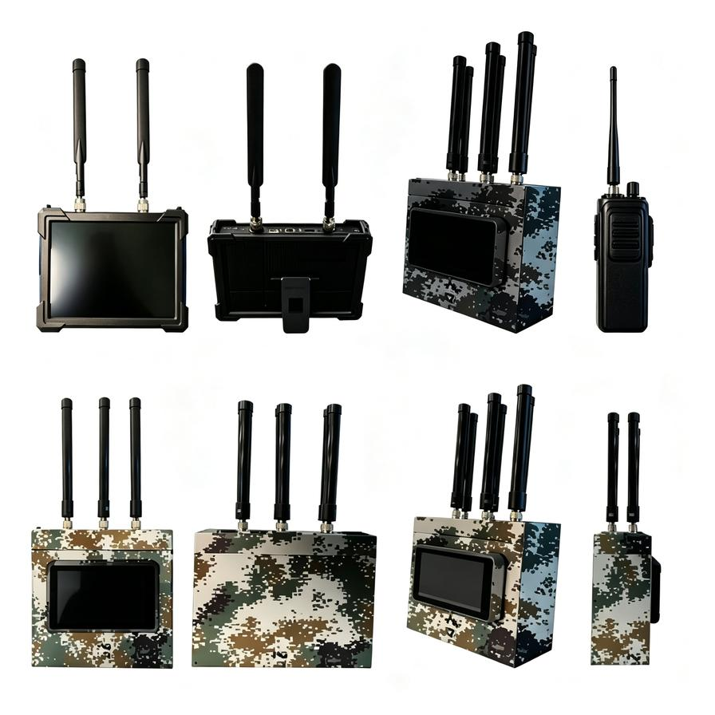
13 — PRODUCT MATRIX
Six form factors, organised around site conditions
SV-A1-HHF
Handheld — FPV links
SV-A2-HHD
Handheld — DJI / Autel
SV-A3-POF
Portable — FPV links
SV-A4-POD
Portable — DJI / Autel
SV-A5-BPM
Backpack / mobile node
SV-A6-FSC
Fixed station — AI node centre
FORM FACTOR → SITE REVIEW → WRITTEN SCOPE. Actual configuration, legality, delivery scope and performance require project confirmation.
Figure 2 · SV-A series public appearance reference.
NEW ARK · SV-A ANALYTIC RF · AIRSPACE SECURITY PROJECT REFERENCE
14 / 24

Slide 15
14 — MODEL SELECTION
A consistent engineering view: spectrum, mass, dimensions, coverage
Model | Form factor | Band (GHz) | Mass (kg) | Dimensions (mm) | Radius (km) | Orientation
SV-A1-HHF | Handheld – FPV | 0.17–2.5 | ≤2 | 255×165×55 | R ≥1 | 360°
SV-A2-HHD | Handheld – DJI / Autel | 0.8–6 | ≤2 | 255×165×55 | R ≥1 | 360°
SV-A3-POF | Portable – FPV | 0.1–2.5 | ≤5 | 310×220×80 | R ≥3 | 360°
SV-A4-POD | Portable – DJI / Autel | 0.8–6 | ≤5 | 310×220×80 | R ≥3 | 360°
SV-A5-BPM | Backpack / mobile | 0.1–6.2 | ≤8 | 310×280×110 | R ≥5 | 360°
SV-A6-FSC | Fixed station – AI node centre | 0.1–6.2 | ≤15 | 400×380×130 | R ≥10 | 360°
Mass and dimensions exclude antenna. Every model integrates C2 / radar / acoustic / EO-IR with system health and event recording; software modules are defined per technical plan. All figures are project reference values — verify on site.
Source: SV-A Model Selection matrix, public project reference.
NEW ARK · SV-A ANALYTIC RF · AIRSPACE SECURITY PROJECT REFERENCE
15 / 24

Slide 16
15 — APPLICATION CONTEXTS
Project discussions for critical infrastructure and authorised high-security sites
01
Civil aviation
07
Water & hydropower
Airports, approach corridors
Stations, dams, control hubs
02
Energy & industry
08
Private estates & commercial
Oilfields, refineries, depots, LNG / chemical parks
Villa compounds, golf, resorts
03
Border & ports of entry
09
Authorised defence facilities
Control units, outposts, checkpoints
Bases, warehouses, ammo depots
04
Mining & minerals
10
Government & public institutions
Open-pit and rare-mineral areas
Closed compounds, public institutions
05
Corrections & detention
11
Temporary & mobile projects
Prisons, high-security centres
Field sites, vehicle-borne, events
06
Ports & shipping
Cargo ports, container terminals
Contexts organise perimeter, sensor, communications and governance requirements; they do not establish availability, deployment permission or response authority.
NEW ARK · SV-A ANALYTIC RF · AIRSPACE SECURITY PROJECT REFERENCE
16 / 24

Slide 17
15.1 — CIVIL AVIATION
Airports: aviation coordination must precede every project decision
SCOPE
Civil and regional airports — runways, terminals and outer perimeters.
WHY PASSIVE FIRST
Approach procedures (RNP), airborne and ground communications, GNSS and site Wi-Fi are all live, protected services; any conclusion about selectivity requires independent EMC review.
THREAT PICTURE
Broadcast drone-vs-airfield footage frames alert escalation and event documentation; the clips are context prompts, not independently verified incidents.
PROJECT PREREQUISITES
Independent review of aviation operations, spectrum, site authorisation and electromagnetic compatibility; accountable human review before any project decision.
SV-A ROLE
RF-silent identification and multi-source corroboration layer; no non-interference claim, no performance guarantee in the aviation environment.
Source: SV-A Application Context 01 and Airspace Event References 02A; owner-provided footage, not independently verified.
NEW ARK · SV-A ANALYTIC RF · AIRSPACE SECURITY PROJECT REFERENCE
17 / 24

Slide 18
15.2 — ENERGY & INDUSTRY
High-risk energy facilities: plan from safe buffers outside hazardous areas
INLAND OILFIELDS
Project-level airspace awareness and event-record discussion for well-field, pipeline and external-perimeter conditions.
REFINERIES
Plan perimeter systems from safe buffer zones outside hazardous process areas, with communications protection and written validation.
OIL & GAS STORAGE DEPOTS
Assess tank-farm perimeter context, interface coordination and continuous-maintenance requirements.
LNG & CHEMICAL PARKS
Review hazardous-area boundaries, EMC, site permissions and multi-sensor corroboration as project design inputs.
PLANNING REFERENCE (NEW ARK ENGINEERING GUIDELINE)
Forward early-warning layer 2–5 km outside the perimeter; node spacing around 500 m. Indicative values for site-survey scoping only — not performance claims and subject to written validation.
Source: SV-A Application Context 02, public project reference; deployment planning values are New Ark engineering guidelines.
NEW ARK · SV-A ANALYTIC RF · AIRSPACE SECURITY PROJECT REFERENCE
18 / 24

Slide 19
15.3 — BORDER · CORRECTIONS · DEFENCE · GOVERNMENT
Authorised perimeters: layered sensing, accountable roles, written scope
BORDER & PORTS OF ENTRY
Control units: perimeter alerting, event retention, cross-node coordination. Outposts: power, communications and accountable roles at remote sites. Checkpoints: communications protection for pedestrian and vehicle-dense areas.
CORRECTIONS & DETENTION
Prisons: external perimeters, existing video systems, event corroboration and site permission. High-security centres: layered sensing, alert governance, accountable roles and log retention.
AUTHORISED DEFENCE FACILITIES
Base perimeters, national-defence warehouses and industrial zones, ammunition-depot perimeters — only under competent-authority permission; safe offsets outside hazardous areas and EMC review are prerequisites.
GOVERNMENT & PUBLIC INSTITUTIONS
Closed compounds, parliamentary and major public institutions, confidential facilities — authorised alert exchange, communications protection, data governance and written review.
Source: SV-A Application Contexts 03, 05, 09, 10, public project reference.
NEW ARK · SV-A ANALYTIC RF · AIRSPACE SECURITY PROJECT REFERENCE
19 / 24

Slide 20
15.4 — PORTS · MINING · WATER · PRIVATE · MOBILE
Five more context families, each with its own sensing boundary
PORTS & SHIPPING
Ocean-going cargo ports and container terminals; vessel-communications protection, broad operational areas, automated facilities and multi-party coordination.
MINING & MINERALS
Large open-pit mines organised around wide extraction areas and multi-node sensing; rare-mineral areas with protected zones, perimeter inspection and event audit.
WATER & HYDROPOWER
Large hydropower stations, dams, reservoirs, inland water-control hubs, sluices and pump stations; navigation and communications protection with multi-node event governance.
PRIVATE ESTATES & COMMERCIAL
Luxury villa compounds, golf courses and resorts; authorised privacy protection, property boundaries, public-communications protection and low-impact installation.
TEMPORARY & MOBILE
Field sites, assembly areas, vehicle-borne projects, large outdoor events and approved counter-terror exercises; temporary power, communications, recovery and accountable handover.
Source: SV-A Application Contexts 04, 06, 07, 08, 11, public project reference.
NEW ARK · SV-A ANALYTIC RF · AIRSPACE SECURITY PROJECT REFERENCE
20 / 24

Slide 21
16 — COMPETITIVE LANDSCAPE
Analytic RF is the shared direction; site validation decides the vendor
Dimension | Sentrycs (IL) · CoRF | D-Fend Solutions (IL) · EnforceAir | New Ark · SV-A series
Core technology | Analytical RF / protocol interpretation reference; supplier confirmation required. | Analytical RF / RF-cyber architecture reference; supplier confirmation required. | Precision RF parsing and AI-assisted analysis reference.
Frequency band | Mainstream UAV communication bands; exact public specifications require supplier confirmation. | Supplier-published spectrum information requires confirmation. | 0.1–6.2 GHz system reference; final fit requires project validation.
Coverage reference | Portable and fixed-site references require supplier confirmation and site validation. | Supplier reference requires validation against site conditions and scope. | 1–10 km reference; varies by configuration, site and target environment.
System integration | Project-defined integration reference; interface availability requires supplier confirmation. | Project-defined C2, radar and sensor integration reference; supplier confirmation required. | Project-defined API for authorised C2, radar, acoustic, EO/IR and other sensors.
Response interface | Project-defined and subject to governing approval. | Project-defined and subject to governing approval. | Project-defined and subject to governing approval; no operating method is published.
Safety & result | Safety outcomes require site validation and accountable human roles. | Safety outcomes require site validation and accountable human roles. | Human authorisation, event records and written validation; no outcome guaranteed.
Sources: Sentrycs, D-Fend Solutions and New Ark official websites. Third-party specifications and comparative statements require confirmation with the relevant manufacturer; this is not independent comparative testing.
Key takeaway: analytic RF prioritises signal identification and project-defined integration; any regulated function requires competent-authority approval.
NEW ARK · SV-A ANALYTIC RF · AIRSPACE SECURITY PROJECT REFERENCE
21 / 24

Slide 22
17 — DELIVERY PREREQUISITES
AUTHORISE → VERIFY: permissions, human authorisation, written validation
PERMISSION
EMC REVIEW
HUMAN ROLE
AUDIT
PRE-HANDOVER CHECKLIST
01
Competent-authority approval and site authorisation in place for the full lawful scope.
02
Protected-services register and independent EMC review completed and signed off.
03
Qualified human roles, escalation paths and role permissions defined in writing.
04
Event logging, change control, maintenance ownership and independent validation confirmed.
This page provides no frequency, power, suppression, target-selection, navigation manipulation, remote-execution or automated-response procedure. Regulatory-sensitive capabilities are disabled by default and assessed only with complete approval, site authorisation, qualified personnel and written safety procedures.
Source: SV-A Governance 08 — AUTHORISE → VERIFY, public project reference.
NEW ARK · SV-A ANALYTIC RF · AIRSPACE SECURITY PROJECT REFERENCE
22 / 24

Slide 23
18 — FAQ & PROJECT START
Nine questions projects ask before the first site survey
01
vs wideband blocking?
PROJECT START PATH
Identification, corroboration and governed interface — not wider emission.
02
Radar / acoustic / EO/IR / C2?
01
Technical consultation and site questionnaire
Yes — project-defined APIs fuse every sensing layer.
03
Civil airports?
02
Spectrum-context review and protected-services register
Only after independent EMC review and site authorisation.
04
The 1–10 km figure?
System reference; varies by configuration, site and target.
05
0.1–6.2 GHz for every model?
03
Site survey and node-topology proposal
No — model-specific; see the selection table.
06
24/7 operation?
04
Tabletop validation and EMC review
Depends on power, networks, personnel and authority conditions.
07
Navigation functions default?
Disabled by default; assessed only under written authority.
05
Written scope, roles, audit and phased delivery
08
Comms protection?
Protected-service register, local rules, EMC, independent validation.
09
How to begin?
Technical consultation before any site survey or commitment.
Source: SV-A FAQ (public project reference); configuration, authority, spectrum use and operating conditions require competent-authority confirmation.
NEW ARK · SV-A ANALYTIC RF · AIRSPACE SECURITY PROJECT REFERENCE
23 / 24

Slide 24
NEW ARK · AIRSPACE SECURITY
PROTECT THE AIRSPACE WITHOUT POLLUTING THE SPECTRUM.
SV-A analytic RF — identification and governed response for sensitive perimeters.
PROJECT ENQUIRY
EXW PRICING · USD
newarkcuas.com/airspace-security
SV-A1-HHF
$35,000
Request an analytic-RF project consultation
SV-A2-HHD
$35,000
SV-A3-POF
$750,000
SV-A4-POD
$800,000
SV-A5-BPM
$250,000
SV-A6-FSC
$300,000
PROJECT REFERENCE ONLY — NO PERFORMANCE OR INTERFERENCE-FREE CLAIM · © 2026 NEW ARK
24 / 24

