Slide 1
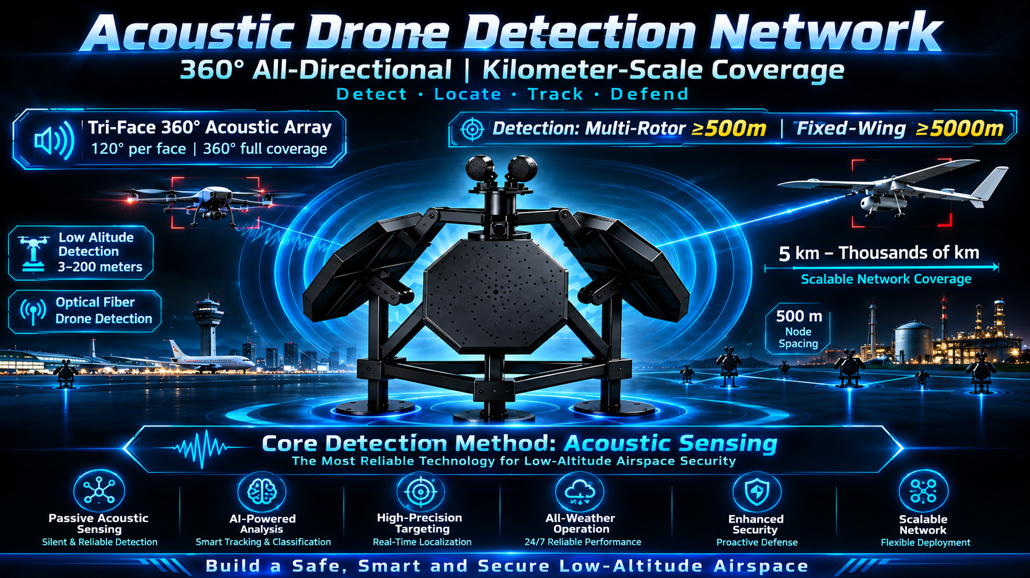
An indispensable core method for fiber optic UAVs and low-altitude flight detection
Acoustic Detection Array
·Passive Acoustic Detection
· Zero RF Emission
· Multi-array Networking
Global Recruitment · For Agents / Distributors / System Integrators
Acoustic Detection Array · Global Recruitment Program
40 Years of Acoustic Expertise · 20 Years of R&D Engineering Team
Notes:
Dear partners, today I would like to introduce our Acoustic Detection Array product. This is a purely passive acoustic detection device with zero RF emission, which does not interfere with any communication signals, making it suitable for critical infrastructure scenarios sensitive to electromagnetic environments. We are now recruiting agents and distributors worldwide.

Slide 2
Table of Contents
01
Industry Status and Competitive Landscape
04
New Cooperation Models
Global Acoustic Counter-UAV Market and Key Players
Standalone Use / Integration with RF Sensors
02
Core Product Technical Advantages
05
FAQs and Cooperation Policies
Passive Detection, Zero RF Emission, Multi-target Positioning
API, Delivery Cycle, Cost, Exclusive Agency Rights
03
Array Specifications and Channel Configurations
06
Application Scenarios and Contact Us
Single/Dual/Triple Arrays, 64/128/192 Channels
Low-Altitude Security for Critical Infrastructure in All Scenarios
Notes:
This presentation is divided into six parts. First, we will look at the industry status and competitive landscape, then introduce the core technical advantages of the product, followed by array specifications and channel configurations. The fourth part covers two cooperation models, the fifth part addresses frequently asked questions, and finally, we will discuss application scenarios and contact information.

Slide 3
Industry Status and Competitive Landscape
Passive Acoustic Detection Becomes a Must for Low-Altitude Security
Core Parameter Comparison
Comparison Dimension | Our Product | Insignito (System) | Squarehead (System)
Max Array Count | 3 (16 Planned) | 1/Scalable | 1/Scalable
Channel Count | 64/128/192 | 50 | 128
Targets per Array | 16+ | Not Disclosed | Not Disclosed
Cooperation Model | System + Module Integration | System Sales | System Sales
RF Sensor Integration | Supported | Integration Supported | Integration Supported
The demand for zero-electromagnetic-interference passive detection in global critical infrastructure continues to grow. Acoustic detection emits no RF signals, causing no interference to airport navigation, industrial communications or civilian frequency bands, making it the preferred solution for RF-sensitive scenarios.
Key market players include New Ark (China), Insignito, Squarehead, etc., which mainly sell complete systems.
Core Differentiation: We focus on providing high-performance PCBA modules to support partners in secondary development and brand customization. Unlike system sellers like Insignito and Squarehead, we offer greater flexibility and cost advantages, helping customers quickly launch their own branded acoustic detection products.
Business Cooperation Model: Technology Transfer: $300,000 | Core Algorithm Module Supply: $1,800/pcs
Notes:
The global passive acoustic detection market is growing rapidly. New Ark is a major competitor; their 8118F model uses three arrays for 360-degree coverage. Our core advantages are: First, higher channel count (up to 192 channels); Second, more flexible array planning (scalable to 16 arrays in the future); Third, and most importantly, we support module integration, which can be embedded into customers' RF sensors to achieve multi-sensor fusion of acoustics and RF—an ability our competitors lack.

Slide 4
Global Competitor Price Benchmark | Single-Array Hardware Reference Retail (USD)
Market research data compiled from public tender records, distributor quotations and industry reports (2024-2026). Prices are reference ranges for single-array complete hardware units.
Company | Country | Representative Product | Channels | Ref. Price (USD) | Remarks
Squarehead Technology | Norway | Discovair G2+ | 128-ch | $42,000-58,000 | High-end benchmark, with optical camera, 360 hemisphere, NATO procurement premium
Insignito | Israel | DUMBO | 64-128ch | $28,000-40,000 | Low SWaP, modular, multi-node networking, IDF validated model
SPHEAR Sound Intelligence | EU | SPHEAR Detect | 64-128ch | $26,000-38,000 | Perimeter acoustic source localization, infrastructure security focus
OptiNav | USA | Drone Hound | 64-128ch | $30,000-44,000 | Acoustic imaging beamforming, US GSA schedule product
SonicEye | Poland | SonicEye-360 | 64-128ch | $22,000-34,000 | Eastern Europe field-deployed, cost-effective European solution
Askalon Industries | France | Acoustic Sentinel | 64-128ch | $24,000-36,000 | Edge AI, SAPIENT compatible, border project oriented
SONIS | Romania | SONIS-AcuNode | 64-ch | $16,000-24,000 | Eastern Europe value option, acoustic-first C-UAS
BeephoniX | EU | BeephoniX Defense Node | 64-ch | $18,000-26,000 | Lightweight outdoor array, compact form factor
DroSonic | USA | DroSonic Percept | 64-128ch | $27,000-39,000 | Edge AI processing, North American security market
ACU Labs | US/EU | ACU-Acoustic Array | 64-128ch | $25,000-37,000 | Array hardware + algorithm kit output model
Cydra Defense | USA | Acoustic-Grid Node | 64-ch | $21,000-30,000 | Multi-node mesh networking architecture
PROMETHEUS | USA | Passive Acoustic EW Unit | 64-128ch | $29,000-42,000 | US military early-warning program prototype system
Key Insight: All competitors sell complete finished units. Our PCBA module-only model enables partners to build branded products at 40-60% lower BOM cost, capturing the margin currently held by integrators.
Notes:
The global passive acoustic detection market is growing rapidly. New Ark is a major competitor; their 8118F model uses three arrays for 360-degree coverage. Our core advantages are: First, higher channel count (up to 192 channels); Second, more flexible array planning (scalable to 16 arrays in the future); Third, and most importantly, we support module integration, which can be embedded into customers' RF sensors to achieve multi-sensor fusion of acoustics and RF—an ability our competitors lack.

Slide 5
Core Technical Advantages of the Product
Passive Acoustic Detection Only, Zero RF Emission
Key Technical Parameters
01 Zero Electromagnetic Interference — No RF signals are transmitted, with no impact on airport navigation, industrial wireless, or civilian communications, ideal for RF-sensitive scenarios.
02 Multi-target Localization — Based on microphone array beamforming and TDOA algorithms, it can identify, classify, and locate multiple drone targets simultaneously.
03 All-weather Operation — Unaffected by light, haze, rain, or snow, it enables 24/7 continuous monitoring, filling the blind spots of optical and radar systems in severe weather.
04 Acoustic Fingerprint Library — Built-in real-time drone acoustic fingerprint database, supporting identification of multi-rotor, fixed-wing, FPV, etc., with continuous updates.
05 Array Networking — Supports multi-node array networking, with a single array covering 120°, three arrays for 360° omnidirectional coverage, and a networking distance of up to several kilometers.
Detection Range
Multi-rotor 500m+ / Fixed-wing 5km+
Coverage Angle
Single Array 120° / Three Arrays 360°
Simultaneous Targets
Single Array 16+ / Three Arrays 48+
Channel Configuration
64 / 128 / 192 Channels
Operating Temperature
-30℃ ~ +65℃
Protection Level
IP65 Industrial Grade
Data Source: Suburban testing results may vary depending on the environment..
Notes:
Our acoustic detection array has five core advantages: zero electromagnetic interference, multi-target localization, all-weather operation, acoustic fingerprint library, and array networking. In terms of key parameters, the detection range for multi-rotor drones is over 500 meters, and for fixed-wing drones over 2 kilometers. Three arrays achieve 360° omnidirectional coverage, tracking more than 48 targets simultaneously. Channel configurations are optional from 64 to 192 channels, the operating temperature ranges from -30°C to +65°C, and it has IP65 industrial-grade protection. These parameters are leading in the industry.

Slide 6
Ultra-Low Altitude Detection Advantage
3-200m Altitude Band | The Critical Layer Where Radar & RF Reach Their Limits
Acoustic Detection Excels at 3-200m
Multi-rotor 500m+ / Fixed-wing 5km+
Radar ground clutter: Severe multipath reflection below 200m drastically reduces radar detection probability.
RF signal obstruction: Buildings, walls and terrain block RF in urban canyons and perimeter zones, creating physical blind spots.
Optical limitations: Cameras fail at night, in fog, rain, or when drones fly behind structures; small FPV drones are hard to acquire visually.
Most intrusion altitude: Over 85% of unauthorized drone incursions at critical sites occur between 3-200m AGL.
Sound bends around obstacles: Acoustic waves diffract over walls, around buildings and through vegetation, reaching the array even without line-of-sight.
No ground clutter: Acoustic sensing is unaffected by radar multipath or ground reflection; every drone motor produces a unique acoustic signature.
All-weather, all-light: Works 24/7 in fog, rain, snow, darkness and smoke — conditions that disable optical and thermal sensors.
Ideal for perimeter & urban: Perfect for airport fence lines, prison walls, government perimeters, port yards and urban canyon environments.
Single Array 120° / Three Arrays 360°
Single Array 16+ / Three Arrays 48+
64 / 128 / 192 Channels
-30℃ ~ +65℃
IP65 Industrial Grade
Notes:
Our acoustic detection array has five core advantages: zero electromagnetic interference, multi-target localization, all-weather operation, acoustic fingerprint library, and array networking. In terms of key parameters, the detection range for multi-rotor drones is over 500 meters, and for fixed-wing drones over 2 kilometers. Three arrays achieve 360° omnidirectional coverage, tracking more than 48 targets simultaneously. Channel configurations are optional from 64 to 192 channels, the operating temperature ranges from -30°C to +65°C, and it has IP65 industrial-grade protection. These parameters are leading in the industry.

Slide 7
Fiber-Optic Guided Drone Detection
Acoustic Detection is the ONLY Reliable Means Against RF-Silent Fiber-Optic FPV Drones
The Emerging Threat: RF-Silent Drones
Why Acoustic is the Only Solution
Multi-rotor 500m+ / Fixed-wing 5km+
Fiber-optic FPV link: Operator controls drone via physical fiber cable; video and control signals travel through glass, NOT through radio waves.
Zero RF emission: No control link, no video downlink, no telemetry transmission — completely invisible to RF detection, spectrum analysis and direction-finding systems.
Battle-proven: Widely deployed in recent conflicts for precision strike, reconnaissance and tactical delivery; rapidly proliferating to non-state actors.
Optical limitations: Small size, low altitude and night operations make visual and thermal detection unreliable, especially in urban and cluttered environments.
Motors always make noise: Regardless of control link type, every drone must spin motors and propellers to fly — this acoustic signature is unavoidable and always detectable.
RF cannot detect them: Spectrum analyzers, RF direction finders and protocol-based C-UAS systems see nothing — no signal to intercept, no fingerprint to classify.
Acoustic fingerprint works: Our beamforming array captures motor and propeller acoustic signatures, classifies drone type, and localizes position even in cluttered environments.
Essential for defense & border: Any serious C-UAS architecture for military bases, border zones and critical infrastructure MUST include acoustic detection as the only countermeasure against fiber-optic drones.
Single Array 120° / Three Arrays 360°
Single Array 16+ / Three Arrays 48+
64 / 128 / 192 Channels
-30℃ ~ +65℃
IP65 Industrial Grade
Notes:
Our acoustic detection array has five core advantages: zero electromagnetic interference, multi-target localization, all-weather operation, acoustic fingerprint library, and array networking. In terms of key parameters, the detection range for multi-rotor drones is over 500 meters, and for fixed-wing drones over 2 kilometers. Three arrays achieve 360° omnidirectional coverage, tracking more than 48 targets simultaneously. Channel configurations are optional from 64 to 192 channels, the operating temperature ranges from -30°C to +65°C, and it has IP65 industrial-grade protection. These parameters are leading in the industry.

Slide 8
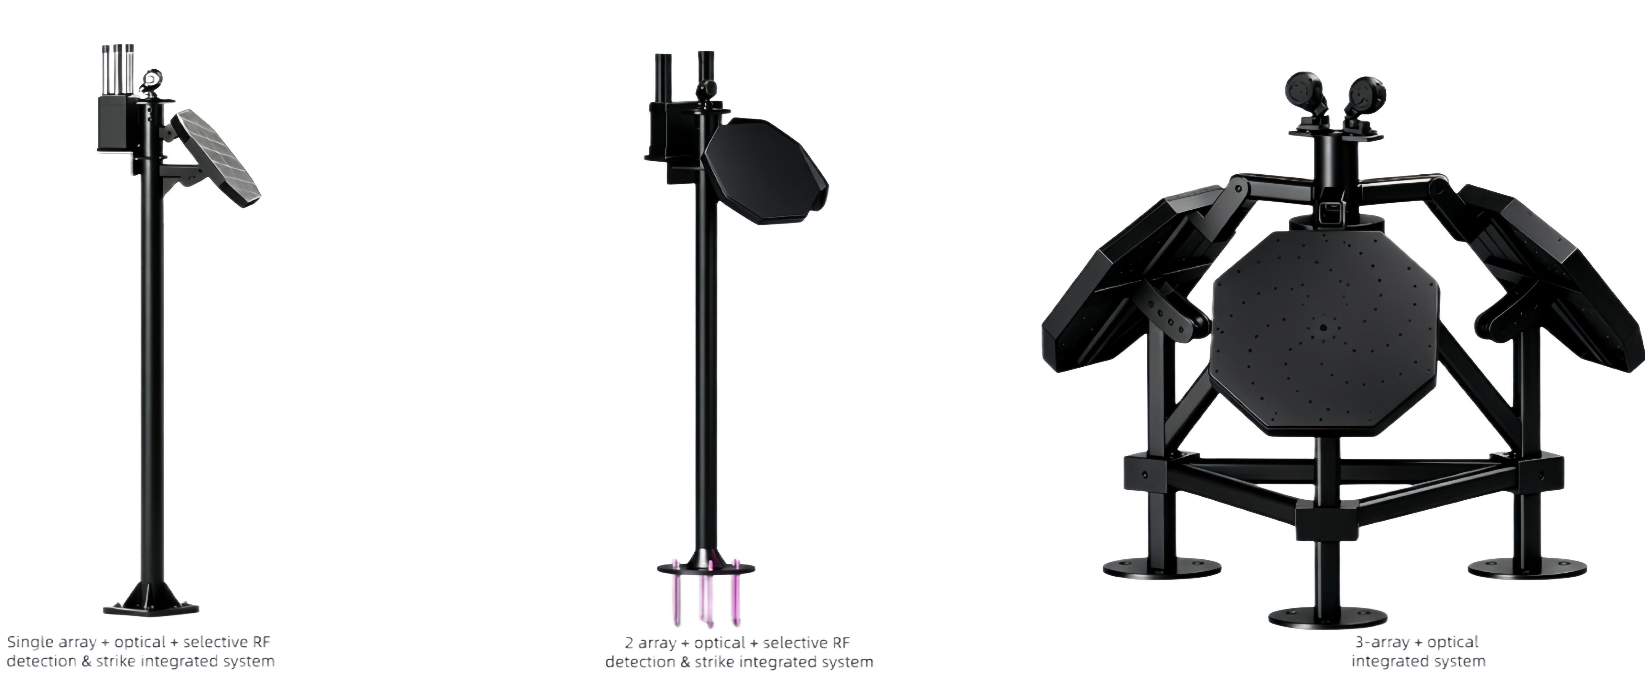
Array Specifications and Channel Configurations
Array Specification Matrix — From Single to 16 Arrays, Flexible Coverage for All Scenarios
Specification | Single Array | Dual Arrays | Triple Arrays | 4/8 Arrays (Planned) | 16 Arrays (Planned)
Coverage Angle | 120° | 240° | 360° Omni | 360°+Redundancy | Ultra-Large Net
Concurrent Targets | 16+ | 32+ | 48+ | 64~128+ | 256+
Typical Scenarios | Key Directions | Building Facades | Full Perimeter | Large Parks | Airports/Ports
Channel Configurations — Three Tiers to Meet Needs from Standard to Flagship
Basic Edition · 64 Channels
Advanced Edition · 128 Channels
Flagship Custom · 192 Channels
Standard Single Array Config
16+ Concurrent Targets
For Small & Medium Sites
Best Value Choice
Recommended Dual Arrays Config
32+ Concurrent Targets
For Large Key Facilities
Main Sales Model
Full Triple Arrays / Scalable
48+ Concurrent Targets
Ultra-Large / Custom Scenarios
Supports 4/8/16 Arrays
Notes:
In terms of array specifications, we currently offer three off-the-shelf options: Single Array, Dual Arrays, and Triple Arrays. A Single Array covers 120 degrees, while Triple Arrays achieve 360-degree omnidirectional coverage. We plan to introduce 4-Array, 8-Array, and 16-Array configurations in the future to meet ultra-large scenario requirements. Channel configurations are divided into three tiers: Basic Edition (64 channels), Advanced Edition (128 channels), and Flagship Custom Edition (192 channels). The Advanced Edition with 128 channels is our mainstream sales model and offers the best cost-performance ratio. The Flagship Edition supports expansion to more arrays.

Slide 9
Business Models and Cooperation Schemes
We focus on core technologies and PCBA module supply, providing flexible business models for partners to support you in building your own branded products.
Model 1: PCBA Module Delivery
Model 2: Custom Algorithm Service
We provide pre-designed finished PCBA modules, and customers can complete the whole machine assembly, manufacturing and brand operation by themselves according to the steps.
• Delivery content: PCBA modules, technical documents, test reports
• Core advantages: Fast market launch, controllable costs, full brand autonomy
• Target audience: Electronic product manufacturers, system integrators, brand owners
Price: 64-channel microphone array PCBA is $3,750, 128-channel microphone array PCBA is $4,950
We do not sell core algorithms, but provide custom algorithm services. Customers need to provide an acoustic database, based on which we optimize and develop algorithms to help you meet application requirements in specific scenarios.
• Delivery content: Custom algorithms, SDK development kits, technical support
• Core advantages: High customization, protection of core technologies, rapid improvement of product competitiveness
• Target audience: RF sensor manufacturers, anti-UAV system developers, military enterprises
Notes:
We offer two cooperation models. The first is As-is complete machine delivery, suitable for agents, distributors and system integrators. It is ready to use out of the box, with zero R&D investment and fast market launch. The second is integration into RF sensors, suitable for RF sensor manufacturers and anti-UAV system developers. We provide acoustic detection core modules and algorithm authorization, embedded into customers' existing hardware to achieve multi-sensor fusion of acoustics and RF, resulting in a 1+1>3 effect. This is our core capability that distinguishes us from competitors like New Ark, who only sell complete machines and do not open up module integration.

Slide 10
FAQs and Cooperation Policies
Q1
Are API/SDK interfaces provided?
Q2
What is the production and delivery cycle?
The Integrated Machine Mode offers standard network protocol interfaces (TCP/IP, MQTT), supporting the push of alarm data, target coordinates, and acoustic features, and can connect to mainstream security platforms.
The Integration Mode provides a complete algorithm SDK, including C/C++ and Python call interfaces, as well as hardware reference design documents, supporting in-depth customized development.
Prototypes/Samples: Delivered within 5-7 working days after confirming requirements.
Small batch (less than 10 units): 10-15 working days.
Large batch (more than 100 units): Negotiated based on order quantity, usually 15-20 working days, and can be delivered in batches.
Module delivery for Integration Mode: 15-20 working days.
Q3
What is the estimated cost and price range?
Q4
Is regional exclusive agency supported?
Basic version (64-channel single array): Channel price is negotiable, highly competitive.
High-end version (128-channel triple array): The main model with the best cost performance.
Flagship version (192-channel): Custom configuration, quoted by project.
Integrated module mode: Priced by authorization method + bulk tiered pricing, better prices for larger quantities.
Specific quotations are negotiated separately based on configuration, quantity, and cooperation mode.
National/regional exclusive agency rights are supported, evaluated based on market potential and partner strength.
Exclusive agency conditions: Annual procurement commitment, local technical service capabilities, and market promotion plans.
Agency benefits: Regional exclusive protection, channel price protection, priority supply, joint promotion, technical training and certification.
There is an assessment period in the first year, and the contract is automatically renewed upon meeting the standards.
Notes:
This page answers the four most concerned questions of partners. First, regarding APIs and SDKs, the Integrated Machine Mode provides standard network protocol interfaces, and the Integration Mode provides a complete algorithm SDK. Second, the delivery cycle: prototypes are delivered within 15-20 working days, small batches within 30-45 days, and large batches within 60-90 days. Third, pricing: divided into basic, high-end, and flagship versions, with specific quotations negotiated separately based on configuration and quantity. Fourth, exclusive agency: national and regional exclusive agency is supported, with annual procurement commitments and an assessment period, and the contract is renewed upon meeting the standards.

Slide 11
Full-Scene Critical Infrastructure Low-Altitude Security
Passive acoustic detection, zero RF interference, suitable for high-security scenarios sensitive to electromagnetic environments
Energy & Chemical Industry
Border Security
Prisons, Ports & Water Conservancy
Inland oilfields / Refineries
Oil and gas storage areas
LNG chemical parks
Large open-pit mines / Rare minerals
Land border control units
Border posts / Border checkpoints
Border counter-terrorism exercise sites
Remote unmanned sites
Prisons / High-security detention centers
Ocean freight ports / Container terminals
Large hydropower stations / Dams
Inland water conservancy hubs
National Defense & Military
Key Government Areas
Civil Aviation Airports
Military bases / Military industrial zones
National defense warehouses / Ammunition depots
Field camps / Temporary assembly areas
Mobile deployment with convoys
Important closed government parks
Presidential palaces / Parliament compounds
Classified government facilities
Large outdoor public events
Civil airport clear zone protection areas
Low-altitude monitoring around runways
Perimeter security of terminals
Zero RF interference, aviation-friendly
Notes:
Our acoustic detection array is suitable for full-scene critical infrastructure low-altitude security, covering six major categories: Energy & Chemical Industry (oilfields, refineries, LNG facilities, mines), Border Security (border posts, checkpoints, counter-terrorism exercises), Prisons, Ports & Water Conservancy (prisons, ports, hydropower stations), National Defense & Military (military bases, ammunition depots, field camps, mobile convoys), Key Government Areas (government compounds, presidential palaces, parliaments, large events), and Civil Aviation Airports. Airports are most sensitive to RF interference; our purely passive acoustic detection with zero RF emission is an aviation-friendly solution, ideal for airport clear zone protection.

Slide 12
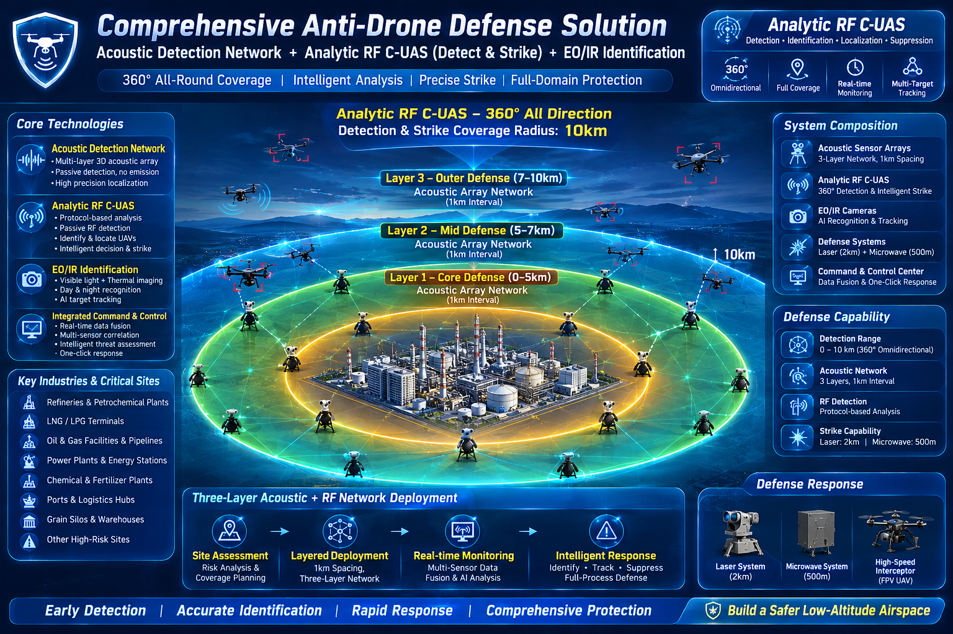
High-Risk Energy Center Defense Solution
Radar-Free Deployment — Acoustic Detection Network + Analytic RF C-UAS for Refineries, LNG Terminals & Petrochemical Plants
Why Radar Cannot Be Deployed
High-power radar emissions risk igniting explosive atmospheres (Zone 0/1 Class I Div. 1)
Electromagnetic interference disrupts plant instrumentation and safety control systems
Strict ATEX / IECEx regulations prohibit active RF emitters near processing units
Three-Layer Acoustic + RF Architecture
Layer 1 — Core Defense (0–5km): Acoustic arrays at 1km intervals + fixed RF station
Layer 2 — Mid Defense (5–7km): Acoustic network ring + portable RF jammers
Layer 3 — Outer Defense (7–10km): Extended acoustic detection + backpack RF units
EO/IR cameras provide visual confirmation at all layers
Key Specs: 360° Coverage | 10km Radius | Zero Active Emission Detection | Protocol-Analytic Jamming (FPV/GPS) | 30+ Simultaneous Targets | Forced Landing / Return
Passive acoustic arrays detect UAV acoustic signatures without any RF emission. Analytic RF jamming targets only hostile drone control links — no collateral interference to plant communications or aviation.
Notes:
For high-risk energy centers such as refineries, LNG terminals, and petrochemical plants, conventional radar systems cannot be deployed due to explosive atmosphere regulations and electromagnetic interference risks. Our solution combines a passive acoustic detection network with analytic RF C-UAS, achieving 360-degree coverage up to 10km without any active radar emission. The three-layer architecture provides graduated defense: core zone 0-5km with fixed RF stations, mid zone 5-7km with portable jammers, and outer zone 7-10km with backpack units. EO/IR cameras add visual confirmation. Protocol-analytic jamming only targets hostile drone links, ensuring zero collateral interference to plant communications and civilian aviation.

Slide 13
Partner Support System
Six Core Supports to Empower Partners
01
Official Brand Authorization
05
After-sales Technical Support
Issue regional authorization certificates, support brand customization and OEM
Three-year warranty, remote technical support, and continuous firmware upgrades
02
Channel Price Protection
06
Joint Marketing Promotion
Tiered pricing system, regional price control, and profit margin protection
Joint exhibitions, case promotion, content sharing, and co-building the brand
03
Technical Training and Certification
Cooperation Process · Six Steps to Start
Full-process training on products, deployment, and debugging, with technical certification issued
Intent Communication → Qualification Assessment → Demo Testing → Signing & Authorization → Training & Launch → Ongoing Support
First-year assessment: automatic renewal if standards are met; conversion to regular distributor if not.
Partners in integration mode have separate technical docking and joint development processes.
04
Pre-sales Solution Support
Support bidding, solution design, on-site surveys, and provide demo units
Notes:
We provide six core supports to our partners: official brand authorization, channel price protection, technical training and certification, pre-sales solution support, after-sales technical support, and joint marketing promotion. The cooperation process consists of six steps: intent communication, qualification assessment, demo testing, signing and authorization, training and launch, and ongoing support. A first-year assessment period is set, with automatic renewal upon meeting standards. Partners in integration mode also have dedicated technical docking and joint development processes. We aim for long-term win-win cooperation with our partners to jointly explore the global low-altitude security market.

Slide 14
Global Deep Technology Cooperation Program
Core PCBA Algorithm Module Supply + In-depth Technology Transfer
We provide core PCBA algorithm modules and authorize distributors or exclusive agents for mass production. The scope of technology transfer includes: PCB Gerber files, PCBA Bom, assembly structure design, software-level authorization, waterproofing process technology, etc. Partners can independently or entrust a third party to complete production and manufacturing.
Reference of Major Global Acoustic Manufacturers
Tier 1: Squarehead Technology
Insignito • SPHEAR Sound Intelligence • OptiNav • SonicEye • Askalon Industries
Business Cooperation Inquiry
Email: partner@yourcompany.com | Official Website: www.yourcompany.com
Feel free to contact us for sample application, technical docking, or quotation inquiry
Acoustic Detection Array · Global Partner Program · 2026
Notes:
Thank you for your attention, partners. We offer various cooperation models: complete machine agency, module integration, regional exclusivity, and joint development. Whether you are a security integrator, RF sensor manufacturer, or a distributor with local channel resources, we have a suitable cooperation plan for you. Please contact us via email or official website to apply for sample testing, technical docking, or quotation inquiry. We look forward to working with you to jointly develop the global low-altitude security market. Thank you all.

Slide 15
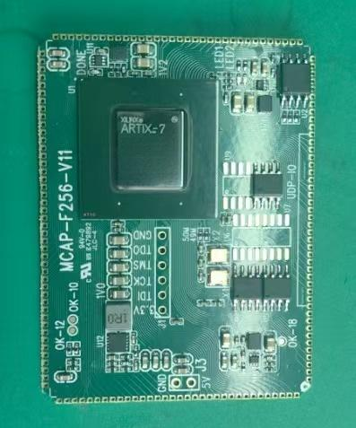



WHY PCBA MODULE COOPERATION?
Why Radar & RF Manufacturers Choose PCBA Supply
01
Instantly Bridge the 20–150m Radar Gap
Developing acoustic array algorithms in-house requires years of field acoustic dataset accumulation. New Ark PCBA boards let radar manufacturers add verified acoustic blind-zone mitigation within weeks.
02
Preserve Brand Identity & Custom Enclosures
OEM partners design proprietary chassis, weatherproof enclosures and brand aesthetics, embedding our core electronics seamlessly for white-label bidding.
03
Complete Windows & Linux SDKs
Cross-platform libraries in C/C++, Python and ROS nodes. Access real-time DOA coordinates, target confidence scores and optional raw audio streams.
HARDWARE & PROTOCOL INTERFACES
PCBA Hardware Interfaces & Specifications
Edge Computing Architecture
Physical Interfaces
Electrical & Environmental
• FPGA + ARM hardware architecture
• Real-time high-speed multi-channel synchronized audio sampling (24-bit / 16 kHz)
• On-device neural-network inference engine (NPU acceleration)
• Ultra-low-latency DOA estimation (< 40 ms)
• 1× Gigabit Ethernet (RJ45 / pin header)
• 2× High-speed RS-485 / RS-422 serial ports
• 1× USB 3.0 debug & log-data export
• 1× GPIO alarm output & opto-isolated hard trigger
• Input voltage: DC 9 V – 36 V wide-range input
• Power: typical consumption < 15 W
• Operating temperature: industrial −40 °C to +85 °C
• Conformal coating (moisture / salt-spray / fungus resistant)
Notes:
Thank you for your attention, partners. We offer various cooperation models: complete machine agency, module integration, regional exclusivity, and joint development. Whether you are a security integrator, RF sensor manufacturer, or a distributor with local channel resources, we have a suitable cooperation plan for you. Please contact us via email or official website to apply for sample testing, technical docking, or quotation inquiry. We look forward to working with you to jointly develop the global low-altitude security market. Thank you all.

Slide 16
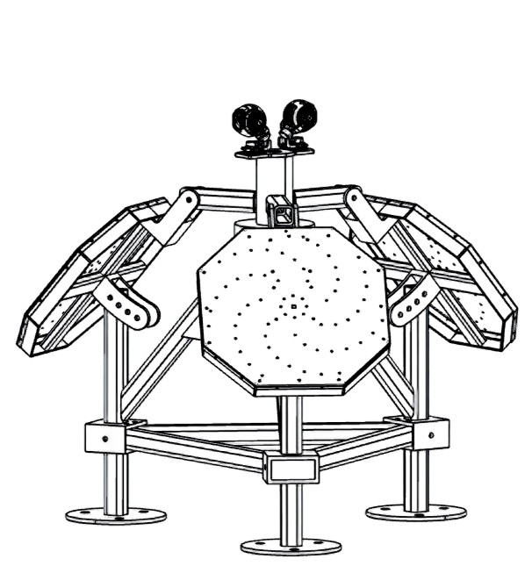
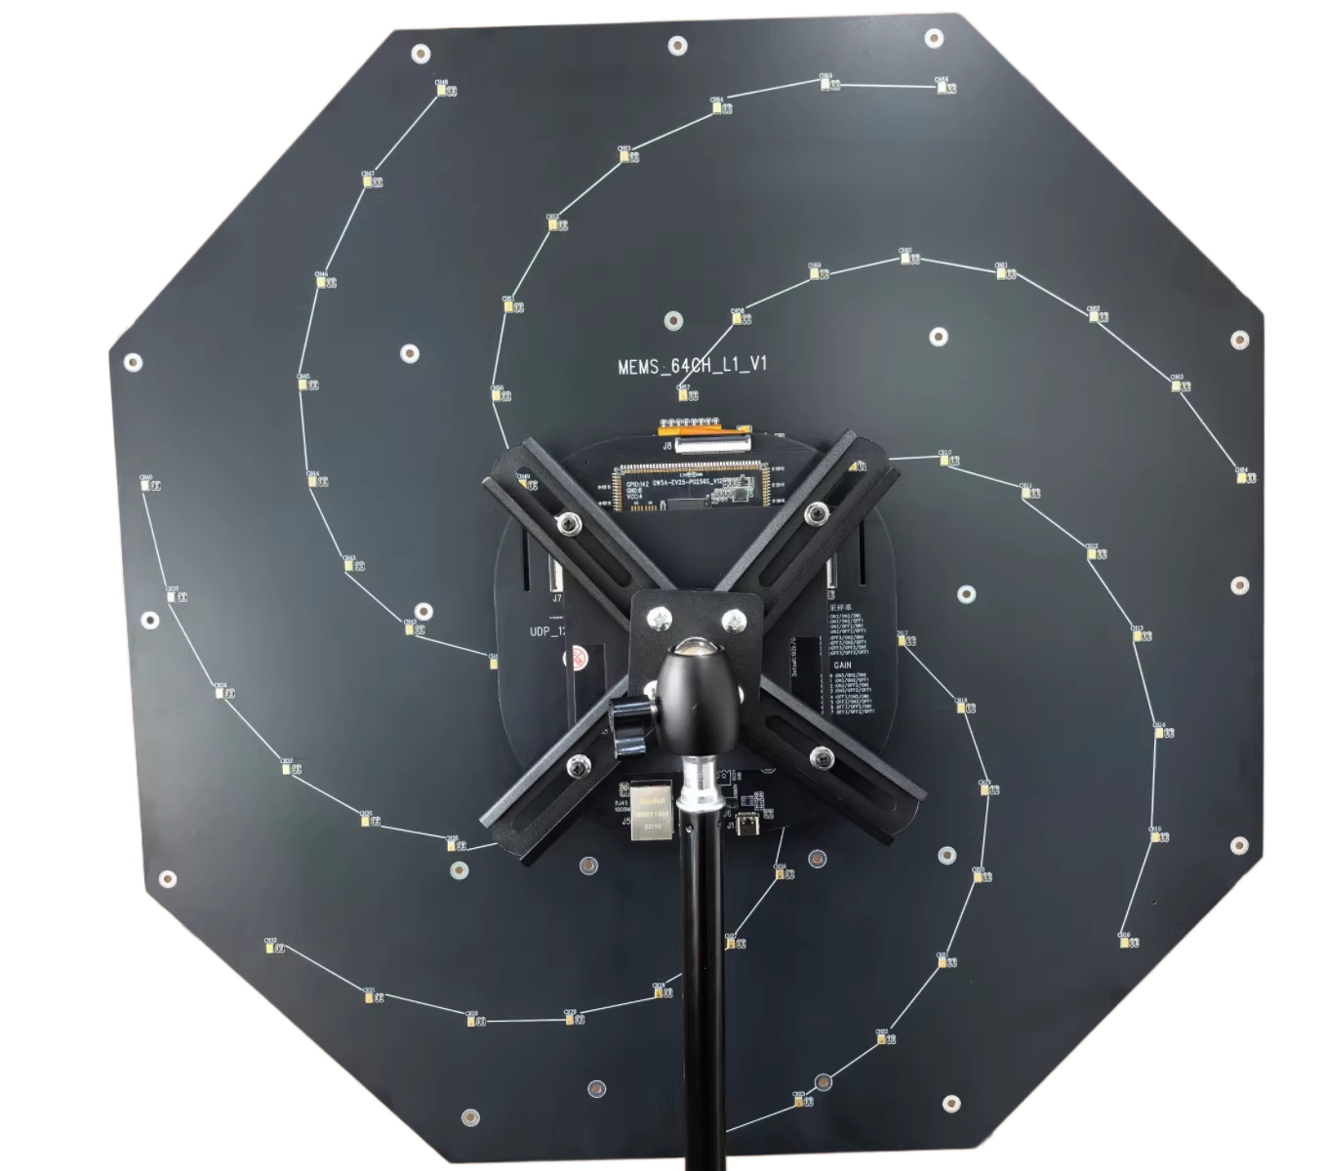
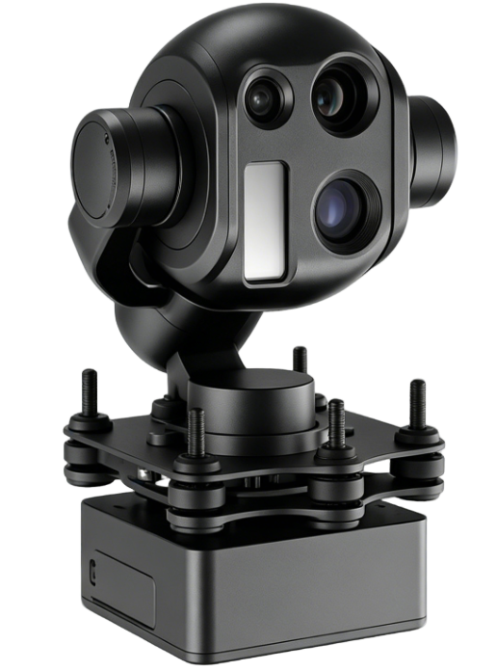
Business Quotation and Cooperation Plan
We offer flexible cooperation models and a transparent pricing system
01 Sample Test Kit
Configuration Item | Unit Price | Remarks
Standard PCBA Array (128-channel) x 3=$14880 | $4,950.00 | Covers 120° FOV, suitable for multiple scenarios
Optical Camera Kit x 2=$9900 | $4,950.00 | High resolution for secondary visual confirmation
One-time Permanent Access License | $12,850.00 | Includes full software components, tools & upgrades
Total for Sample Kit: $37,600.00
Core Hardware Advantages
Equipped with a high-performance FPGA chip integrating our proprietary core visual processing algorithms. Features low power consumption & high stability, designed for complex industrial environments, and seamlessly integrable into various smart terminals.
02 Deep Cooperation Mode
Technology License Transfer | $300,000
Provides complete technical docs (PCB Gerber, BOM, assembly drawings, source code) to support independent production setup.
Core Algorithm PCBA Supply | $1,800/pcs
Pre-loaded core visual algorithm PCBA modules (plug-and-play) to shorten R&D cycles and enable fast integration.
Notes:
Hello everyone, on this page we detail our business quotation and cooperation plan. We offer flexible cooperation models to meet the needs of different customers.
First is the Sample Test Kit, priced at $20,550 in total. It includes 3 standard PCBA arrays, 2 optical camera kits, and a permanent software license, allowing you to quickly evaluate our technical capabilities.
For partners seeking deep cooperation, we provide two options: one is to pay a $300,000 technology license transfer fee to obtain a full set of technical documents for independent production; the other is to directly purchase our core algorithm PCBA modules at a unit price of $1,500 for your complete machine products.
We believe that transparent pricing and flexible cooperation models will be the solid foundation for our successful cooperation.

Slide 17
Analytic RF C-UAS Product Line & Pricing
Full-spectrum protocol-analytic jamming — handheld to fixed-station, 1km to 10km protection, precision strike without collateral interference
Model | Specification | Frequency Range | Coverage | Weight | EXW Price (USD)
SV-A1-HHF | Handheld — FPV | 0.17–2.5 GHz | R ≥ 1km | ≤2 kg | $80,000
SV-A2-HHD | Handheld — DJI/Autel | 0.8–6 GHz | R ≥ 1km | ≤2 kg | $80,000
SV-A3-POF | Portable — FPV | 0.1–2.5 GHz | R ≥ 3km | ≤5 kg | $180,000
SV-A4-POD | Portable — DJI/Autel | 0.8–6 GHz | R ≥ 3km | ≤5 kg | $200,000
SV-A5-BPM | Backpack / Mobile | 0.1–6.2 GHz | R ≥ 5km | ≤8 kg | $350,000
SV-A6-FSC | Fixed Station — AI Node | 0.1–6.2 GHz | R ≥ 10km | ≤15 kg | $400,000
Recommended for Energy Centers: SV-A6-FSC
10km 360° coverage, AI node center, ≥30 simultaneous targets, 5:1–8:1 jamming ratio, IFF capability, optional radar & Starlink modules. Long-term 24/7 operation.
Standard Features Across All Models
Full-duplex detection & jamming | 360° coverage | Self-adaptive frequency & power | Forced landing / return | Navigation jamming (software upgradable) | 3-Year Warranty
Custom Logo & Appearance Customization | Whitelist-Enabled Selective Countermeasure | EXW pricing — volume discounts available for distributor & integrator partners
Notes:
This page presents our complete Analytic RF C-UAS product line with six models ranging from handheld devices at $80,000 to fixed-station AI node centers at $400,000. For high-risk energy centers, we recommend the SV-A6-FSC Fixed Station, which provides 10km 360-degree coverage, can handle 30 or more simultaneous targets, and supports IFF and optional radar/Starlink modules. All models feature full-duplex detection and jamming, self-adaptive frequency and power, forced landing or return capability, and a 3-year warranty. Custom logo and appearance customization is available, and whitelist-enabled selective countermeasure ensures friendly drones are not affected. Volume discounts are available for distributor and system integrator partners.

Slide 18
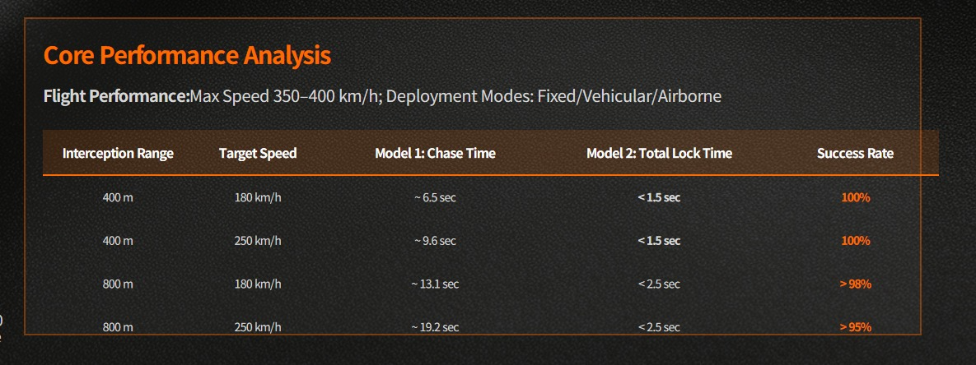
Directed Energy & Kinetic Interception Product Line
Laser, Microwave and High-Speed FPV Interceptor — long-range directed energy, swarm neutralization and kinetic interception with live-fire validation
System | Range / Speed | Primary Targets | Key Capability | Launch Mode | EXW Price (USD)
Laser System | 2 km | Fiber-optic drone, Fixed-wing drone | High-energy directed energy burn-through | Fixed | $4,500,000
Microwave System | 1 km | Fiber-optic drone & drone swarm (1–30+ targets) | Wide-area RF suppression & swarm neutralization | Fixed | $4,500,000
High-Speed FPV Interceptor | 350 km/h | Fiber-optic drone / Fixed-wing drone | Kinetic interception at high approach speed | Manual / Auto | $2,980
FPV Launch Systems
Manual Launcher: $1,000 per unit
Auto Launcher: $50,000 per unit (multi-tube, automated sequencing)
Chengdu Live-Fire Validation
Laser / Microwave / Acoustic Detection / Analytic RF C-UAS
Target drone live-fire test: $3,000 — deductible from subsequent order
FPV Live-Fire Interception Demo
Ttarget drone live-fire test: $2,980/unit —Demo: Huizhou
All systems support integrated deployment with Acoustic Detection Array & Analytic RF C-UAS | EXW pricing
Notes:
This page presents our complete Analytic RF C-UAS product line with six models ranging from handheld devices at $80,000 to fixed-station AI node centers at $400,000. For high-risk energy centers, we recommend the SV-A6-FSC Fixed Station, which provides 10km 360-degree coverage, can handle 30 or more simultaneous targets, and supports IFF and optional radar/Starlink modules. All models feature full-duplex detection and jamming, self-adaptive frequency and power, forced landing or return capability, and a 3-year warranty. Custom logo and appearance customization is available, and whitelist-enabled selective countermeasure ensures friendly drones are not affected. Volume discounts are available for distributor and system integrator partners.

